Slide 1
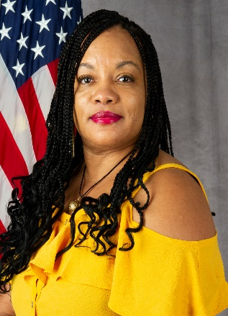
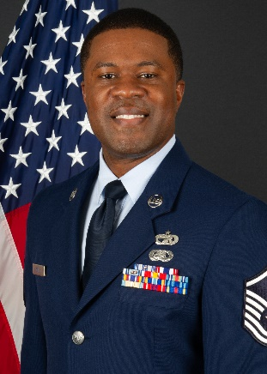
94TH AIRLIFT WING
EQUAL OPPORTUNITY STAFF
Our Mission:
To enhance mission effectiveness by assisting leadership at all levels with creating and maintaining an environment free from unlawful discrimination and harassment (to include sexual harassment), bullying, hazing and reprisal.
Our Goal:
To accomplish our mission by taking proactive steps through education and training to eradicate all forms of unlawful discrimination and harassment from the workplace.
Our Customers:
Military members and their families, retired Military personnel, Department of Defense civilian employees, former employees and applicants for civilian employment.
Services Offered:
Defense Organizational Climate Survey, Alternate Dispute Resolution (ADR) to include Mediation and Facilitation, Teambuilding, Focus Groups, Human Relations Education (HRE), and Formal/Informal Complaint Resolution.
Ms. Nadine Burton
22 Air Force, EEO Program Manager
(Civilian Concerns)
678-655-5094
MSgt Brandon Hosley
EO Specialist
(Traditional Reservist)
The following references are available to further assist you with your EO & ADR concerns:
DAFI 36-2710, Equal Opportunity Program Military and Civilian
29 CFR, Part 1614, Federal Sector Equal Employment Opportunity (Civilian)
Management Directive (MD)-110 (Civilian)
AFI 51-1201, Alternative Dispute Resolution Process in Workplace Disputes
Federal civilian employees must contact the EEO office no later than 45 days from an alleged offense or personnel action
1430 First Street
BLDG 838, Room 1410
Dobbins ARB, GA 30069
Phone: (678) 655-5042
Last Updated November 2022

